Slide 1
Iris Recognition
Ravitha N

Slide 2
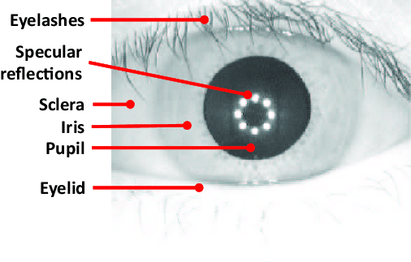
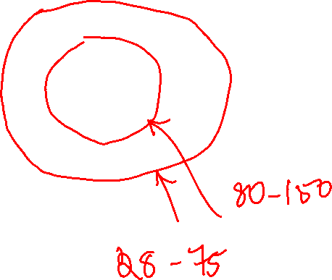
Iris
Iris remains invariant during the entire lifecycle of a person
Colored area between the sclera and the pupil
Rich in texture

Slide 3
General Diagram of Iris Recognition
Matching
Near Infrared Source/ lens Filter
Sensor
Enrollment
Vision Module
Database
Images are Captured at a distance of 30-50 cm
Using Near infrared source of different wavelength 700-900 nm
Processing Module

Slide 4
Main Phases of Iris Image Processing
Iris Code Database
Iris Image Capturing
Iris Segmentation and Localization
Normalization
Feature Extraction
Recognition
Decision

Slide 5
Noteworthy Works
Daugman (1994)
Detection of iris
Pseudo Polar Normalization
Usage of Gabor Wavelets
Wildes (1997)
Hough Transform
Multiresolution Pyramidal representation of iris pattern
Normalized Correlation factor for each frequency band
Linear Discriminant analysis
Masek (2003)(open source)
Hough Transform
Pseudo polar normalization
1D Gabor Filtering

Slide 6
Three Important Stages
Extraction of ROI
Removal of Noise
Pseudo Polar Normalization
Feature Extraction
Matching

Slide 7
Extraction of ROI
ROI is bounded by two circles
an outer circle representing the boundary between iris and sclera
Inner circle representing the boundary between iris and pupil
Circular Hough Transform is used

Slide 8
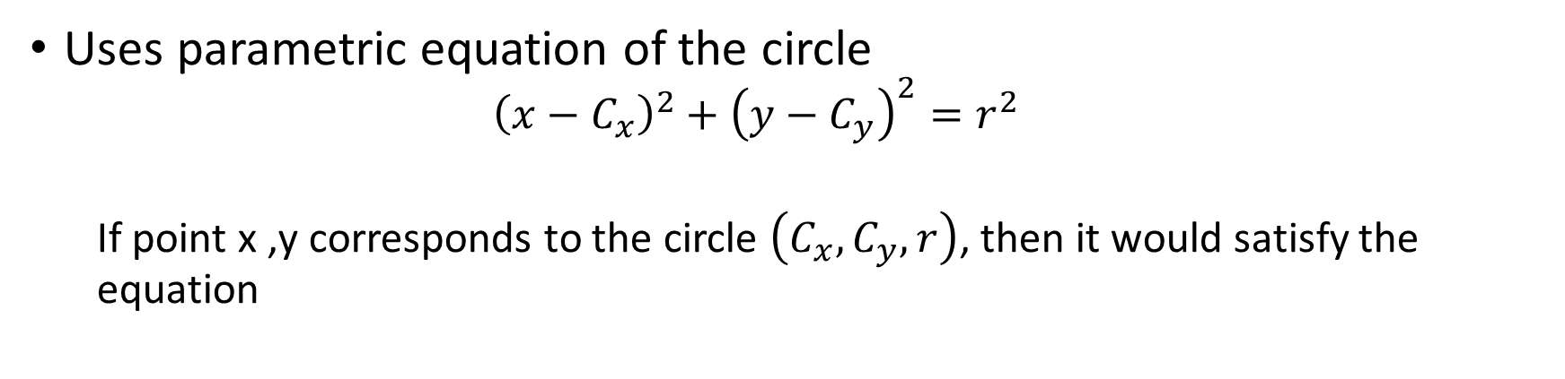
Circular Hough Transform
Uses parametric equation of the circle
$${\left(x−C_{x}\right)}^{2}+{\left(y−C_{y}\right)}^{2}=r^{2}$$
If point x ,y corresponds to the circle $\left(C_{x},C_{y},r\right)$, then it would satisfy the equation

Slide 9
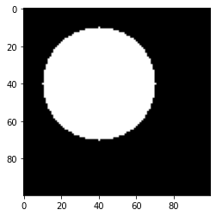
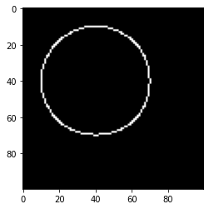




Edge Filtered Image
$$\begin{matrix}\left(100×100\right) \\ \left(40,40,30\right)\end{matrix}$$
Accumulator Array
Fixed R

Slide 10
Identify Points in the edge filtered Image Corresponding to the circle
For every Possible value of Cx and Cy , I Check for whether point satisfy the condition
 |  |  | 1
Populate the accumulator

Slide 11
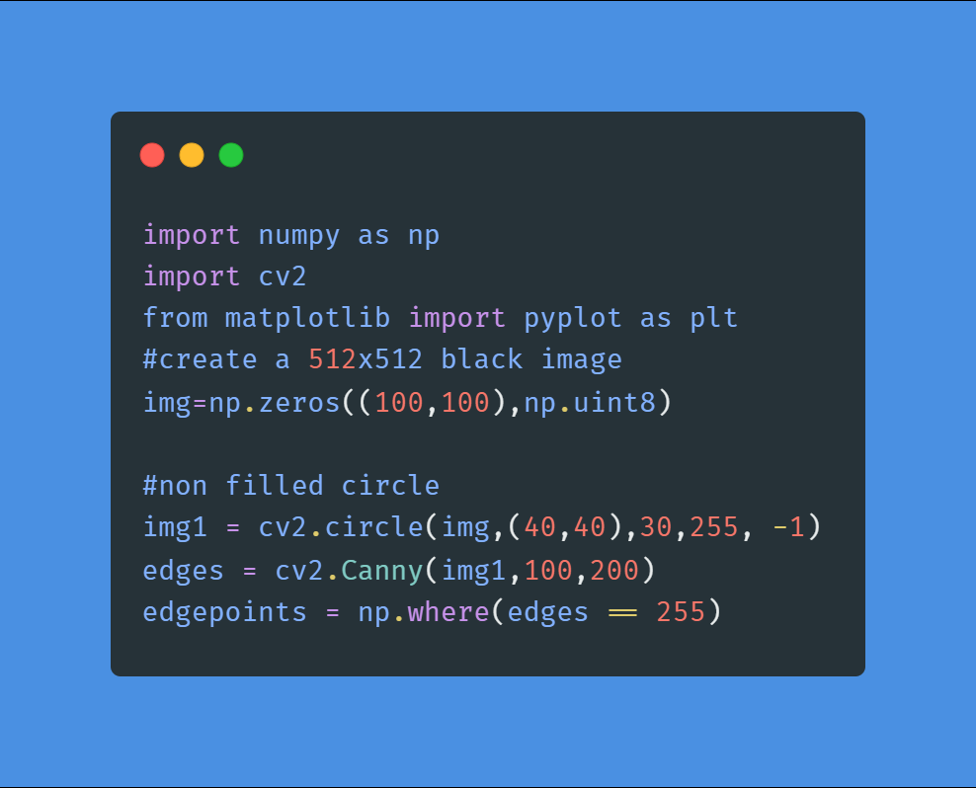
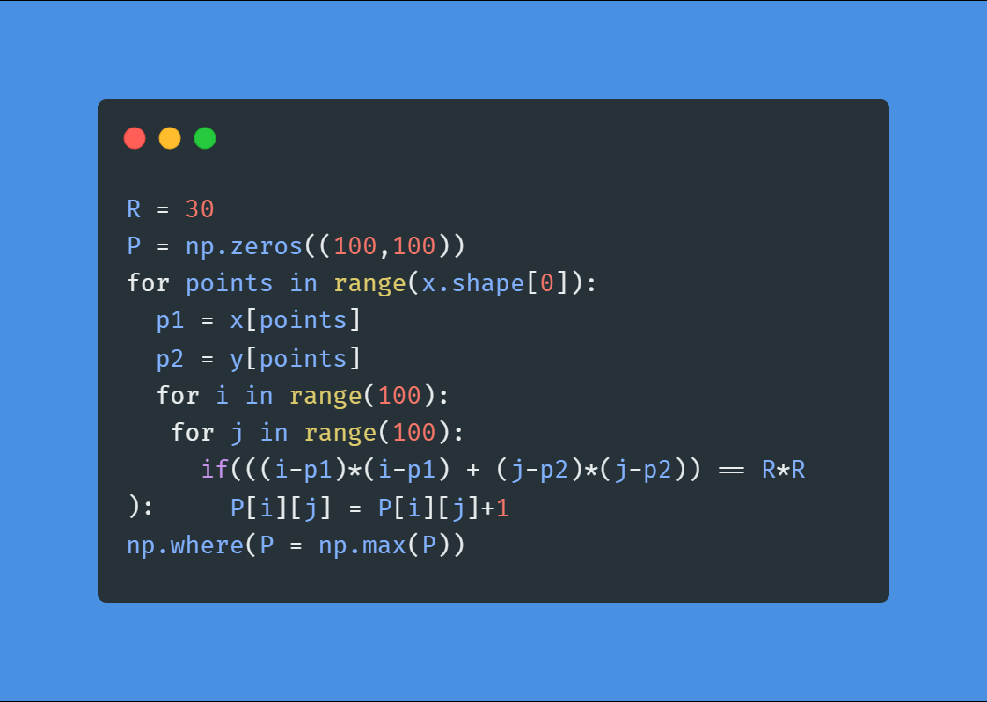
Maximum response in the array correspond to possible circle coordinate

Slide 12
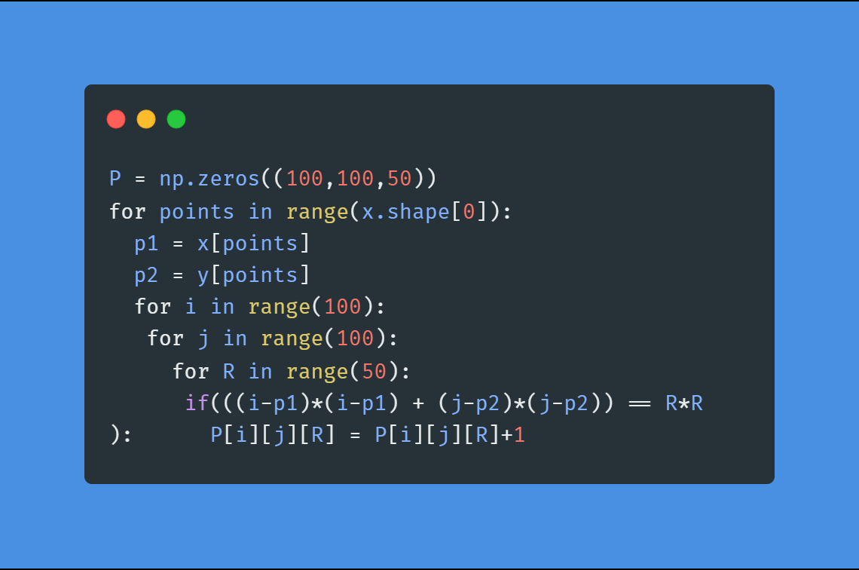
The same can be extended for non –fixed R

Slide 13

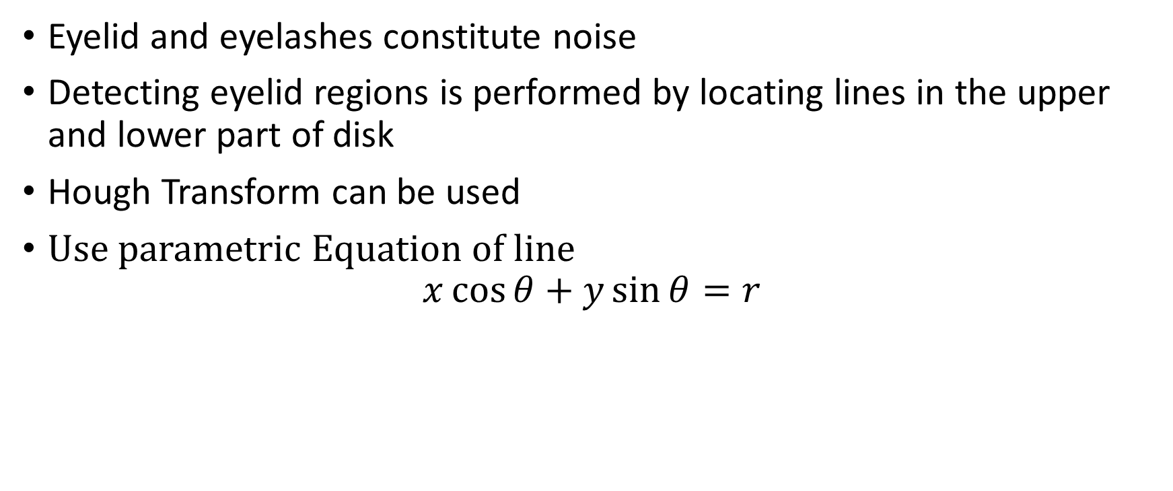

Construction of noise mask
Eyelid and eyelashes constitute noise
Detecting eyelid regions is performed by locating lines in the upper and lower part of disk
Hough Transform can be used
Use parametric Equation of line
$$x\cos{θ}+y\sin{θ}=r$$

Slide 14












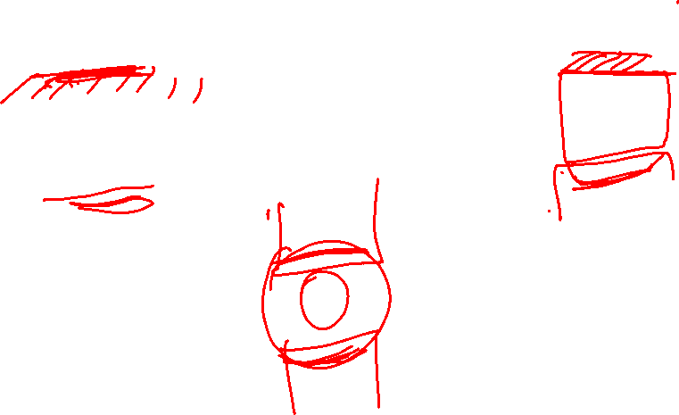













Slide 15
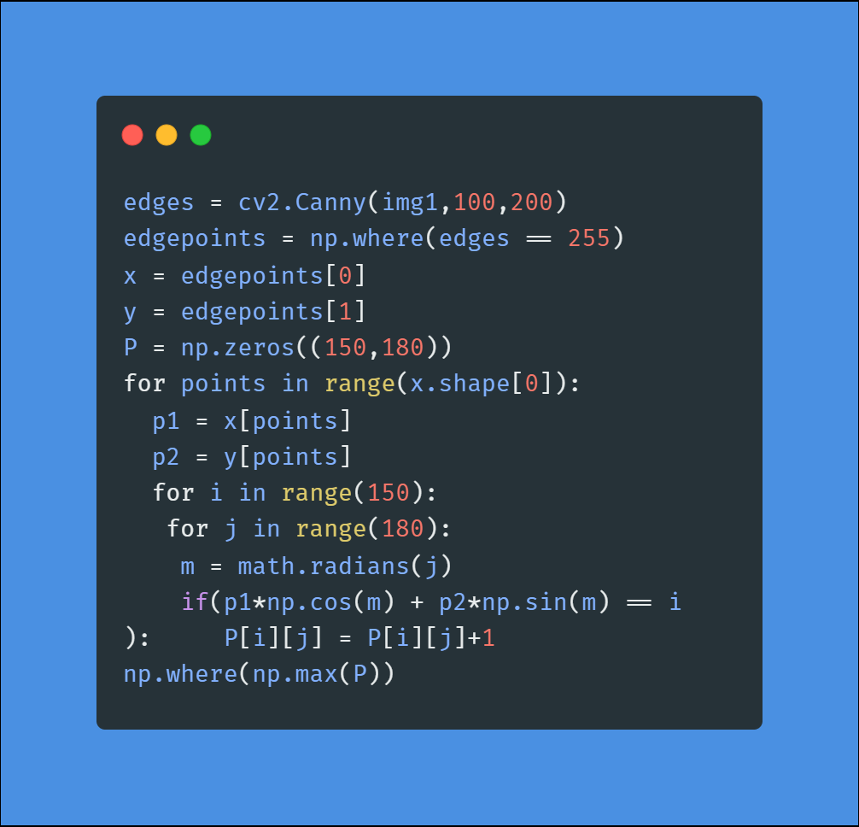
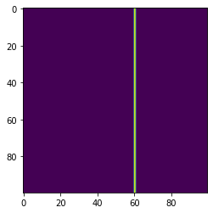
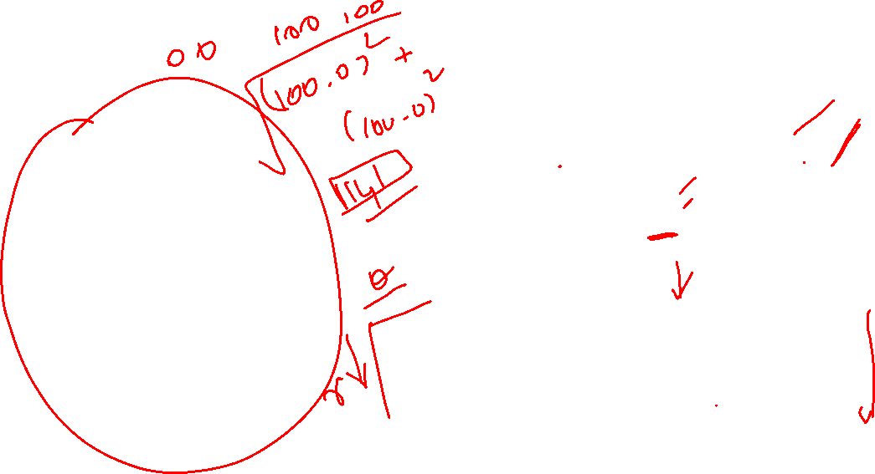

Slide 16


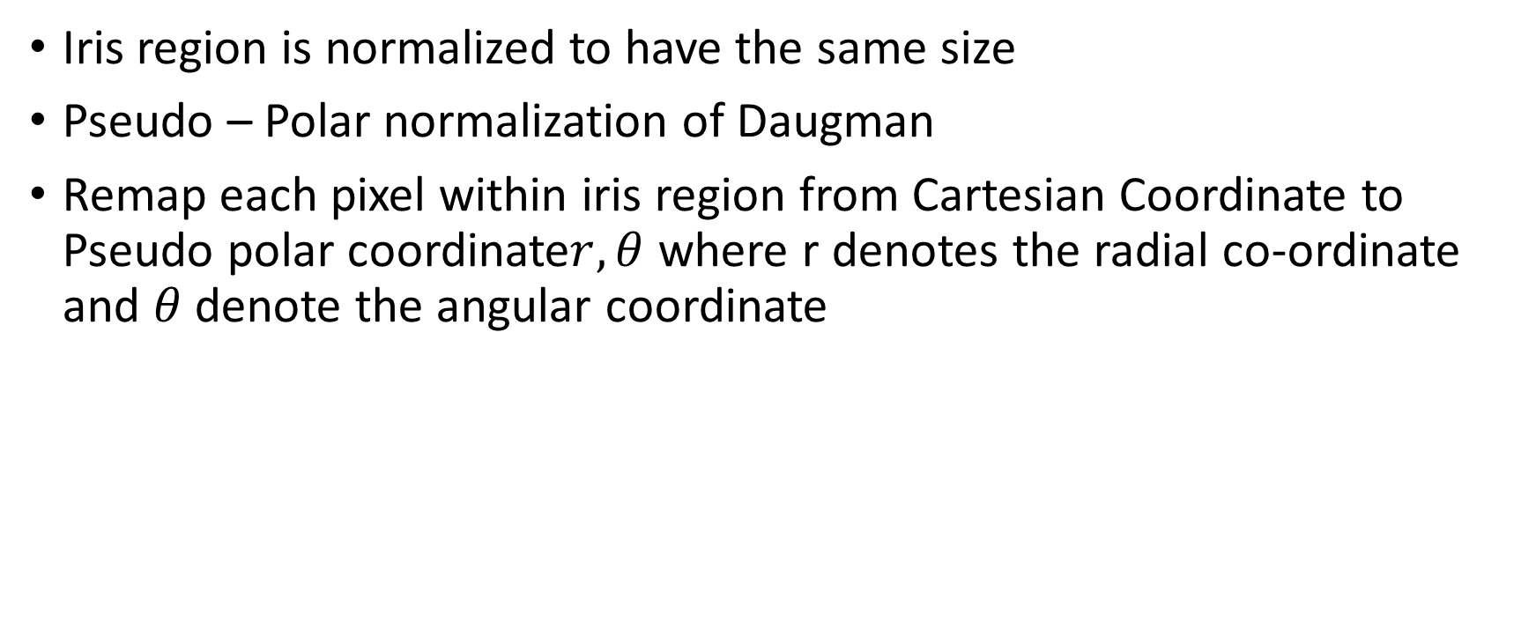







Normalization
Iris region is normalized to have the same size
Pseudo – Polar normalization of Daugman
Remap each pixel within iris region from Cartesian Coordinate to Pseudo polar coordinate$r,θ$ where r denotes the radial co-ordinate and $θ$denote the angular coordinate

Slide 17
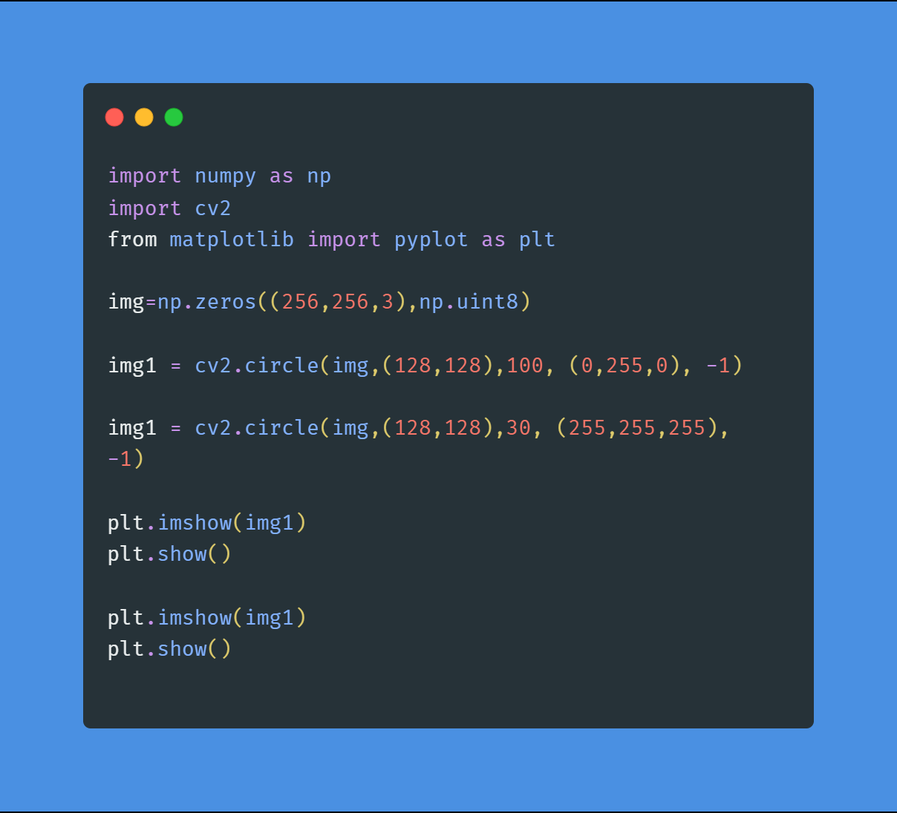
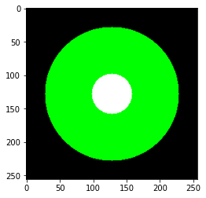

Slide 18

A point on radial direction at distance r and at angle $θ$ is expressed as
$$x\left(γ,θ\right)=\left(1−r\right)x_{p}+rx_{s}$$
$$y_{P}=ℝ_{p}\sin{θ}$$
$$x_{P}=ℝ_{p}\cos{θ}$$

Slide 19
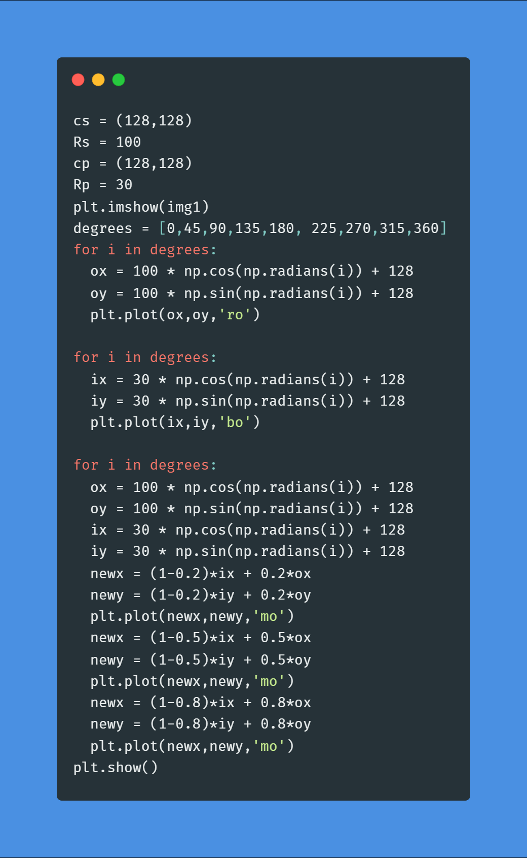


Slide 20
